Slide 1
Upserve Data Analysis
Shimeng Feng
03/04/2018

Slide 2
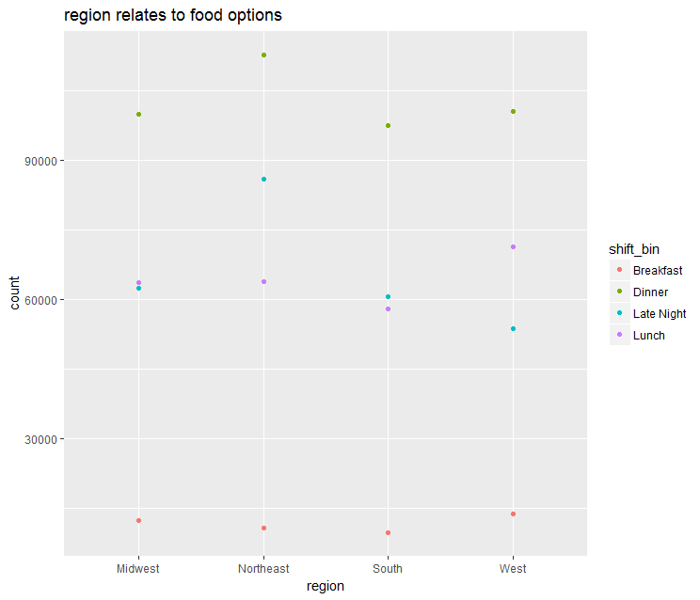
Geographic habit of going out
For region of West, people have tendency eat out more for breakfast, and lunch
For region of Northeast, people have tendency eat out more for late night and dinner
Overall, people have high tendency of eating out for dinner

Slide 3
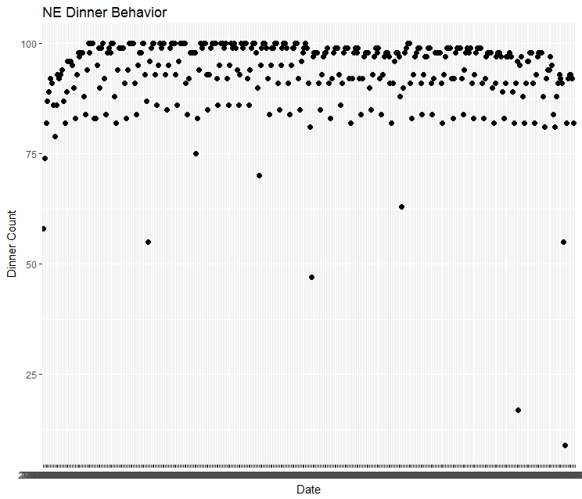
NE Dinner Behavior
Among the NE region dinner behavior across all given date, there are 2 obvious outliers
There are a group of dates when people lack of motivation goes out for dinner
Deep dive in to figure out what are the dates that highly affects people’s behavior

Slide 4
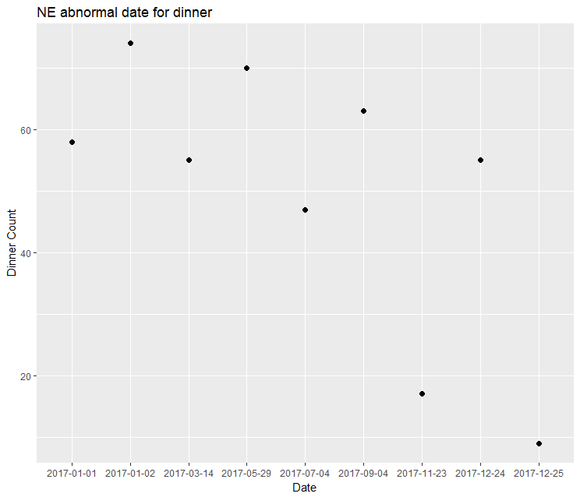
NE Dinner Behavior
Some of the dates reflect the general holidays such as 12/25 for Christmas, 11/23 for Thanksgiving, etc.
We did not see a drop for Super Bowl
However, there are dates shows abnormal behavior such as 3/14, maybe people decide to celebrate Pi day?

Slide 5
Next Step..
Similarly, there are more steps could be developed here
Discover whether similar behavior for other region
Discover whether similar behavior present across different shift bin
Discover whether similar behavior across different types of restaurants and categories
For NE region data, the following could be discovered:
Whether the consumption of alcohol increased during Super Bowl
Whether the number of dinner increased during Valentine’s day
The distribution of certain events across different regions with introduction of US 2017 holiday calendar

